Slide 1
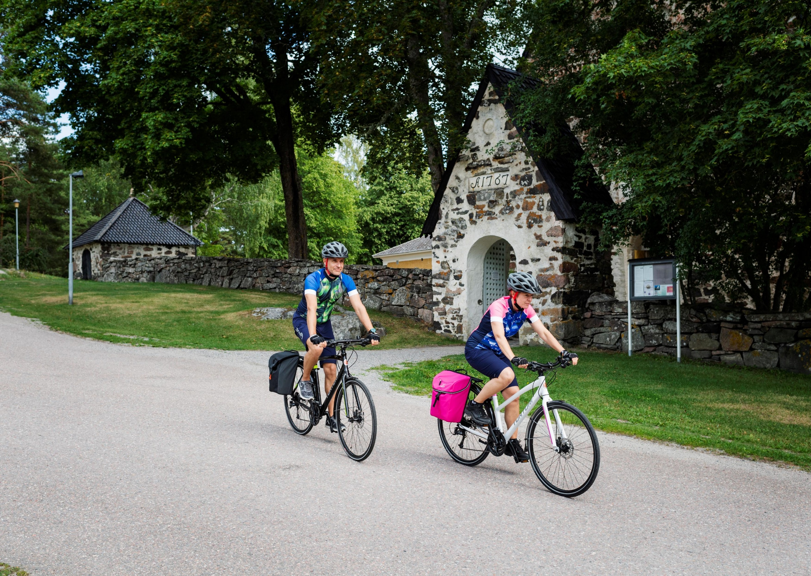

Workshop Model for Developing Cultural Routes
Photo: Juho Kuva, Visit Finland

Slide 2
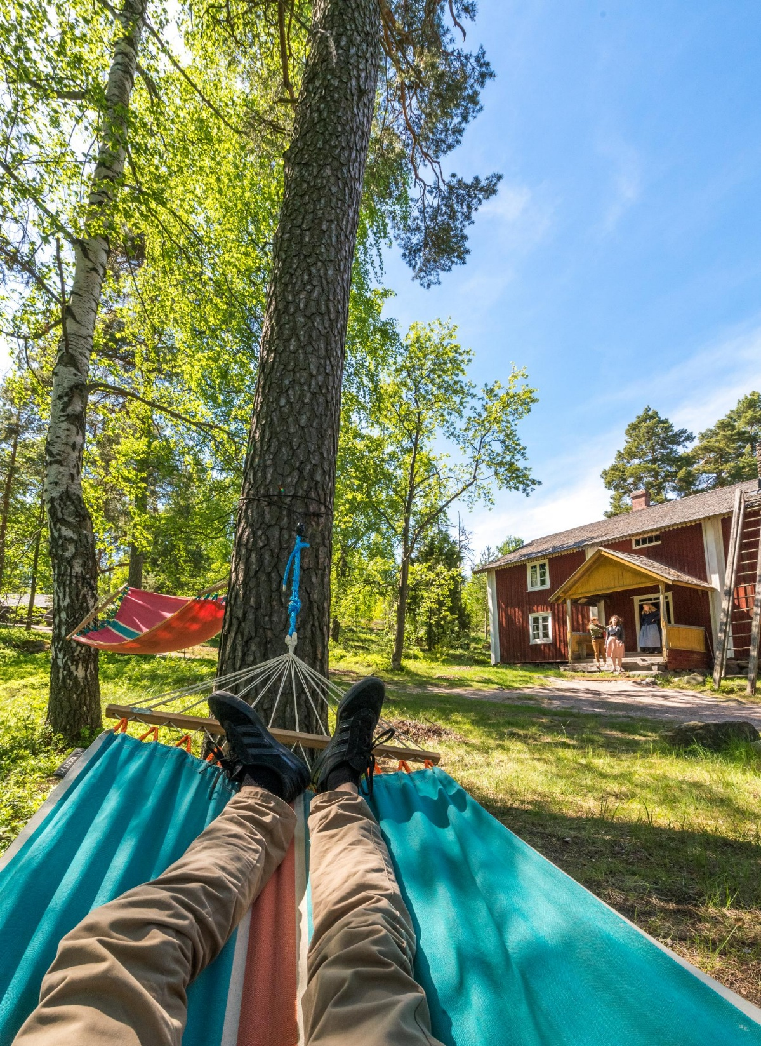

The starting point for building a cultural route of the Council of Europe
The start of building a Cultural Route is typically based on
a situation where some kind of formal or informal cooperation / connection between some organisations already exists.
Who is the initiator?
Who is leading the development work?
Photo: Topi Leikas, The Finnish Heritage Agency

Slide 3
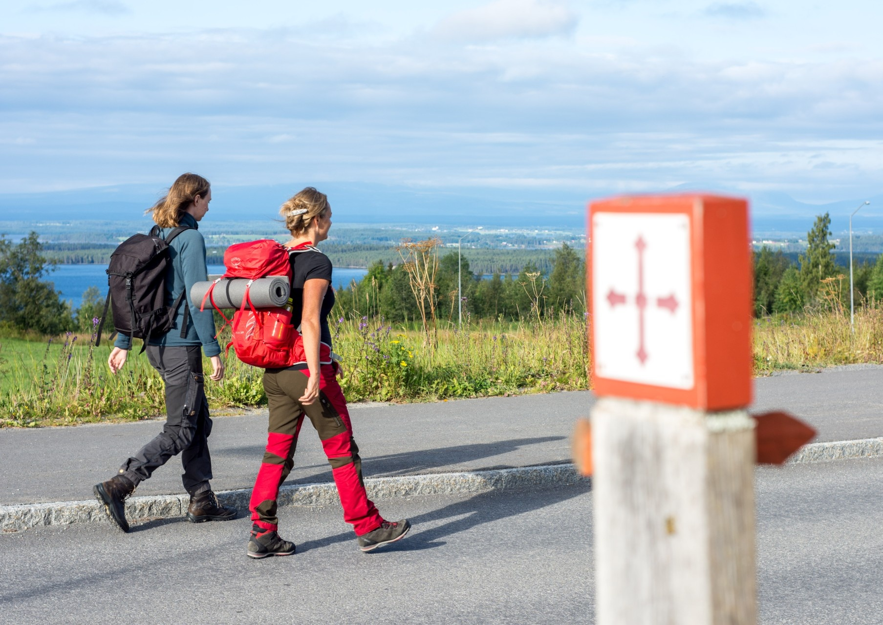
Purpose and Goals
What is the motivator to start building
a Cultural Route?
How can the framework that Cultural Route program provides support the goals of the new Cultural Route network?
How do the goals of the route network support the basic goals of the organisations involved?
Photo: Michel Johansson, St Olavs ways, Sweden
Notes:
Tips:
When the goals of the route network serve the fundamental goals of the participating organisations, membership in the network is beneficial and it is easier to engage members to a new route network or already certified network.
Setting goals is a process that goes hand in hand with growing your network. Goals become more specific and evolve over time. However, it is important to clearly define the basic goals and motivation of the network so that they can be clearly communicated to new members.

Slide 4
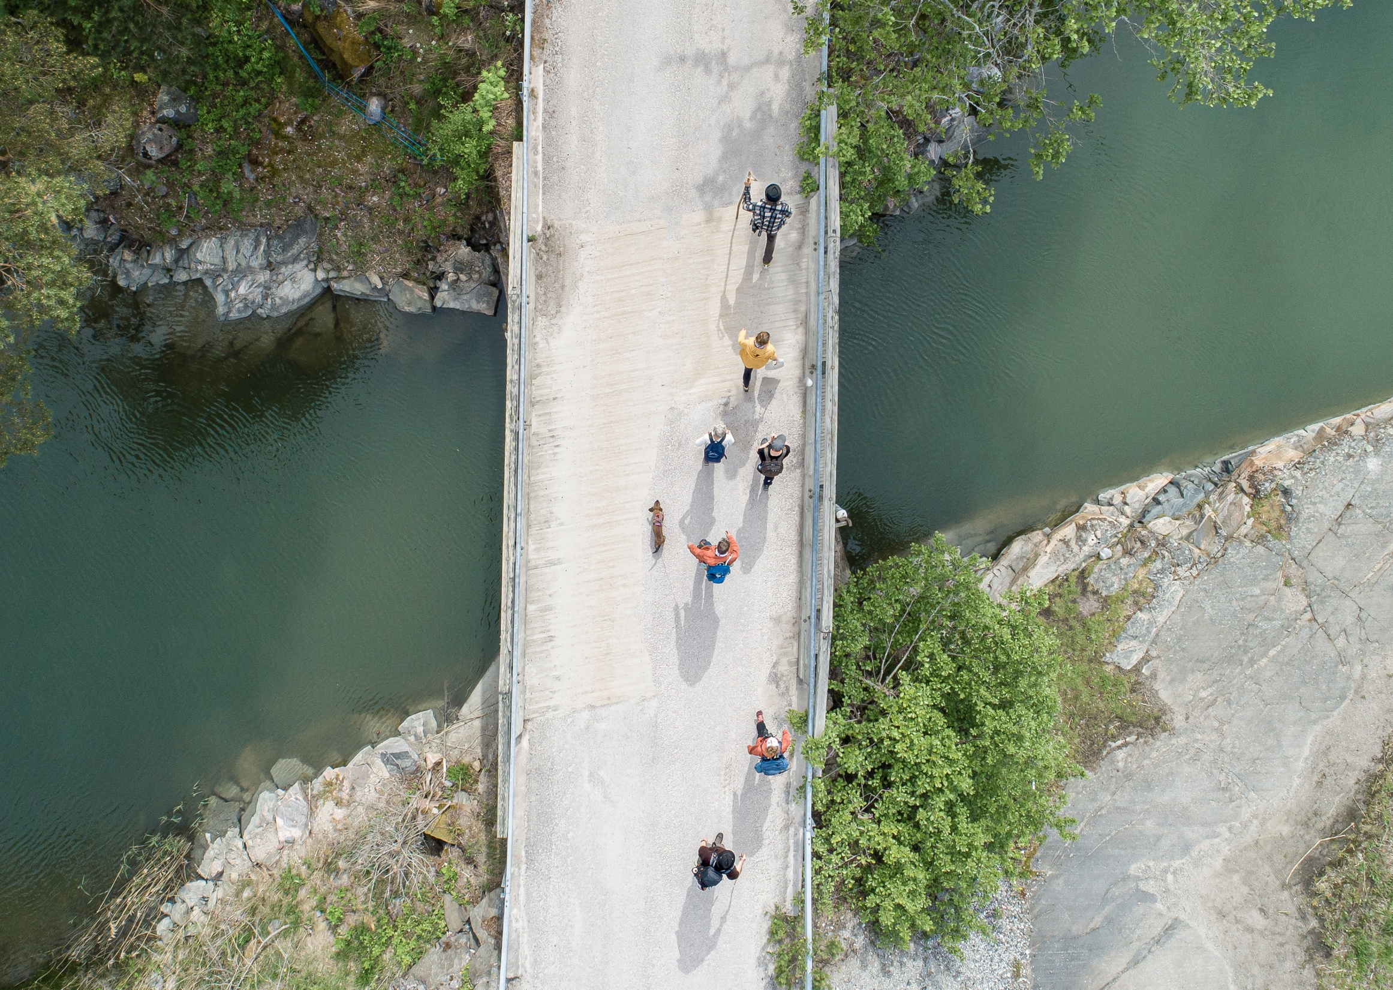
Defining the Theme
What kind of message do you want
to carry with the theme?
What are the values behind the theme? Reflect the theme to the values of
the Cultural Routes of the Council of Europe programme.
What is the story about European culture heritage you wish to share and how can that be summarised as a single theme?
Photo: Jouni Lappi, St Olav Waterways
Notes:
Tips:
Clarify the theme so that it is understandable for people who are unfamiliar with the topic.
Points to consider:
Consider how broad or narrow the theme should be.
Reflect the theme to membership: What kind of organisations can be included to the network? (check the step 4 and 5)

Slide 5
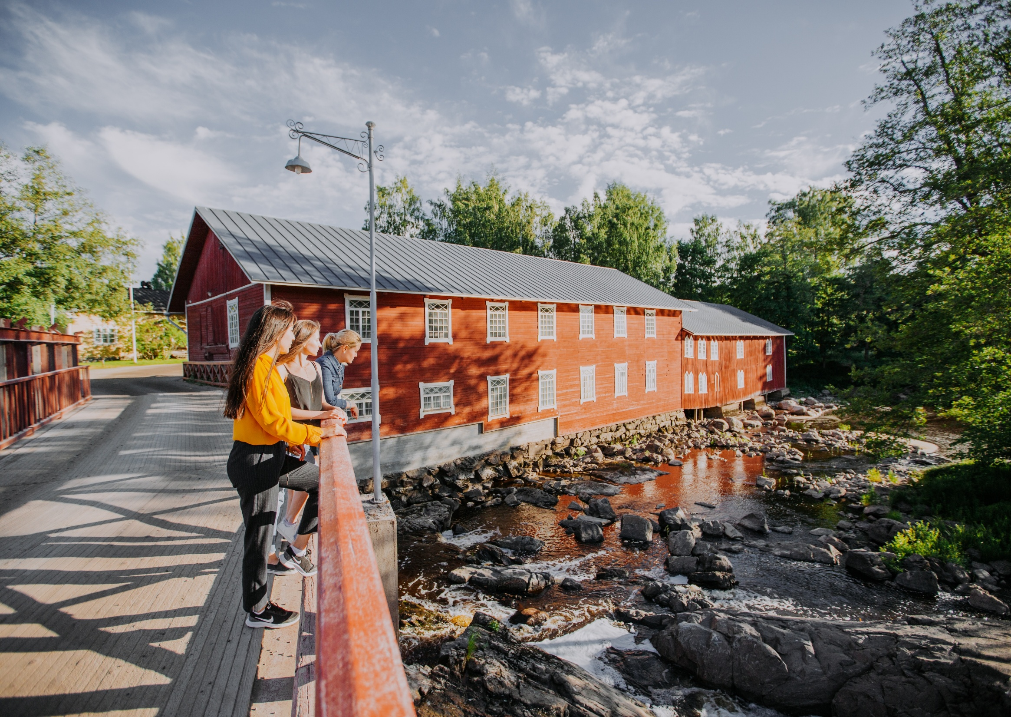
Map the Heritage
Which countries share the same heritage? Which countries can be involved?
Map the places and objects
(both tangible and intangible)
that can be included in the route.
Which organisations are involved with relevant heritage sites, and can they become members?
What is prioritised?
Photo: Julia Kivelä, Visit Finland, The Ahlström Ironworks
Notes:
Points to consider:
There must be members in at least three European countries.

Slide 6
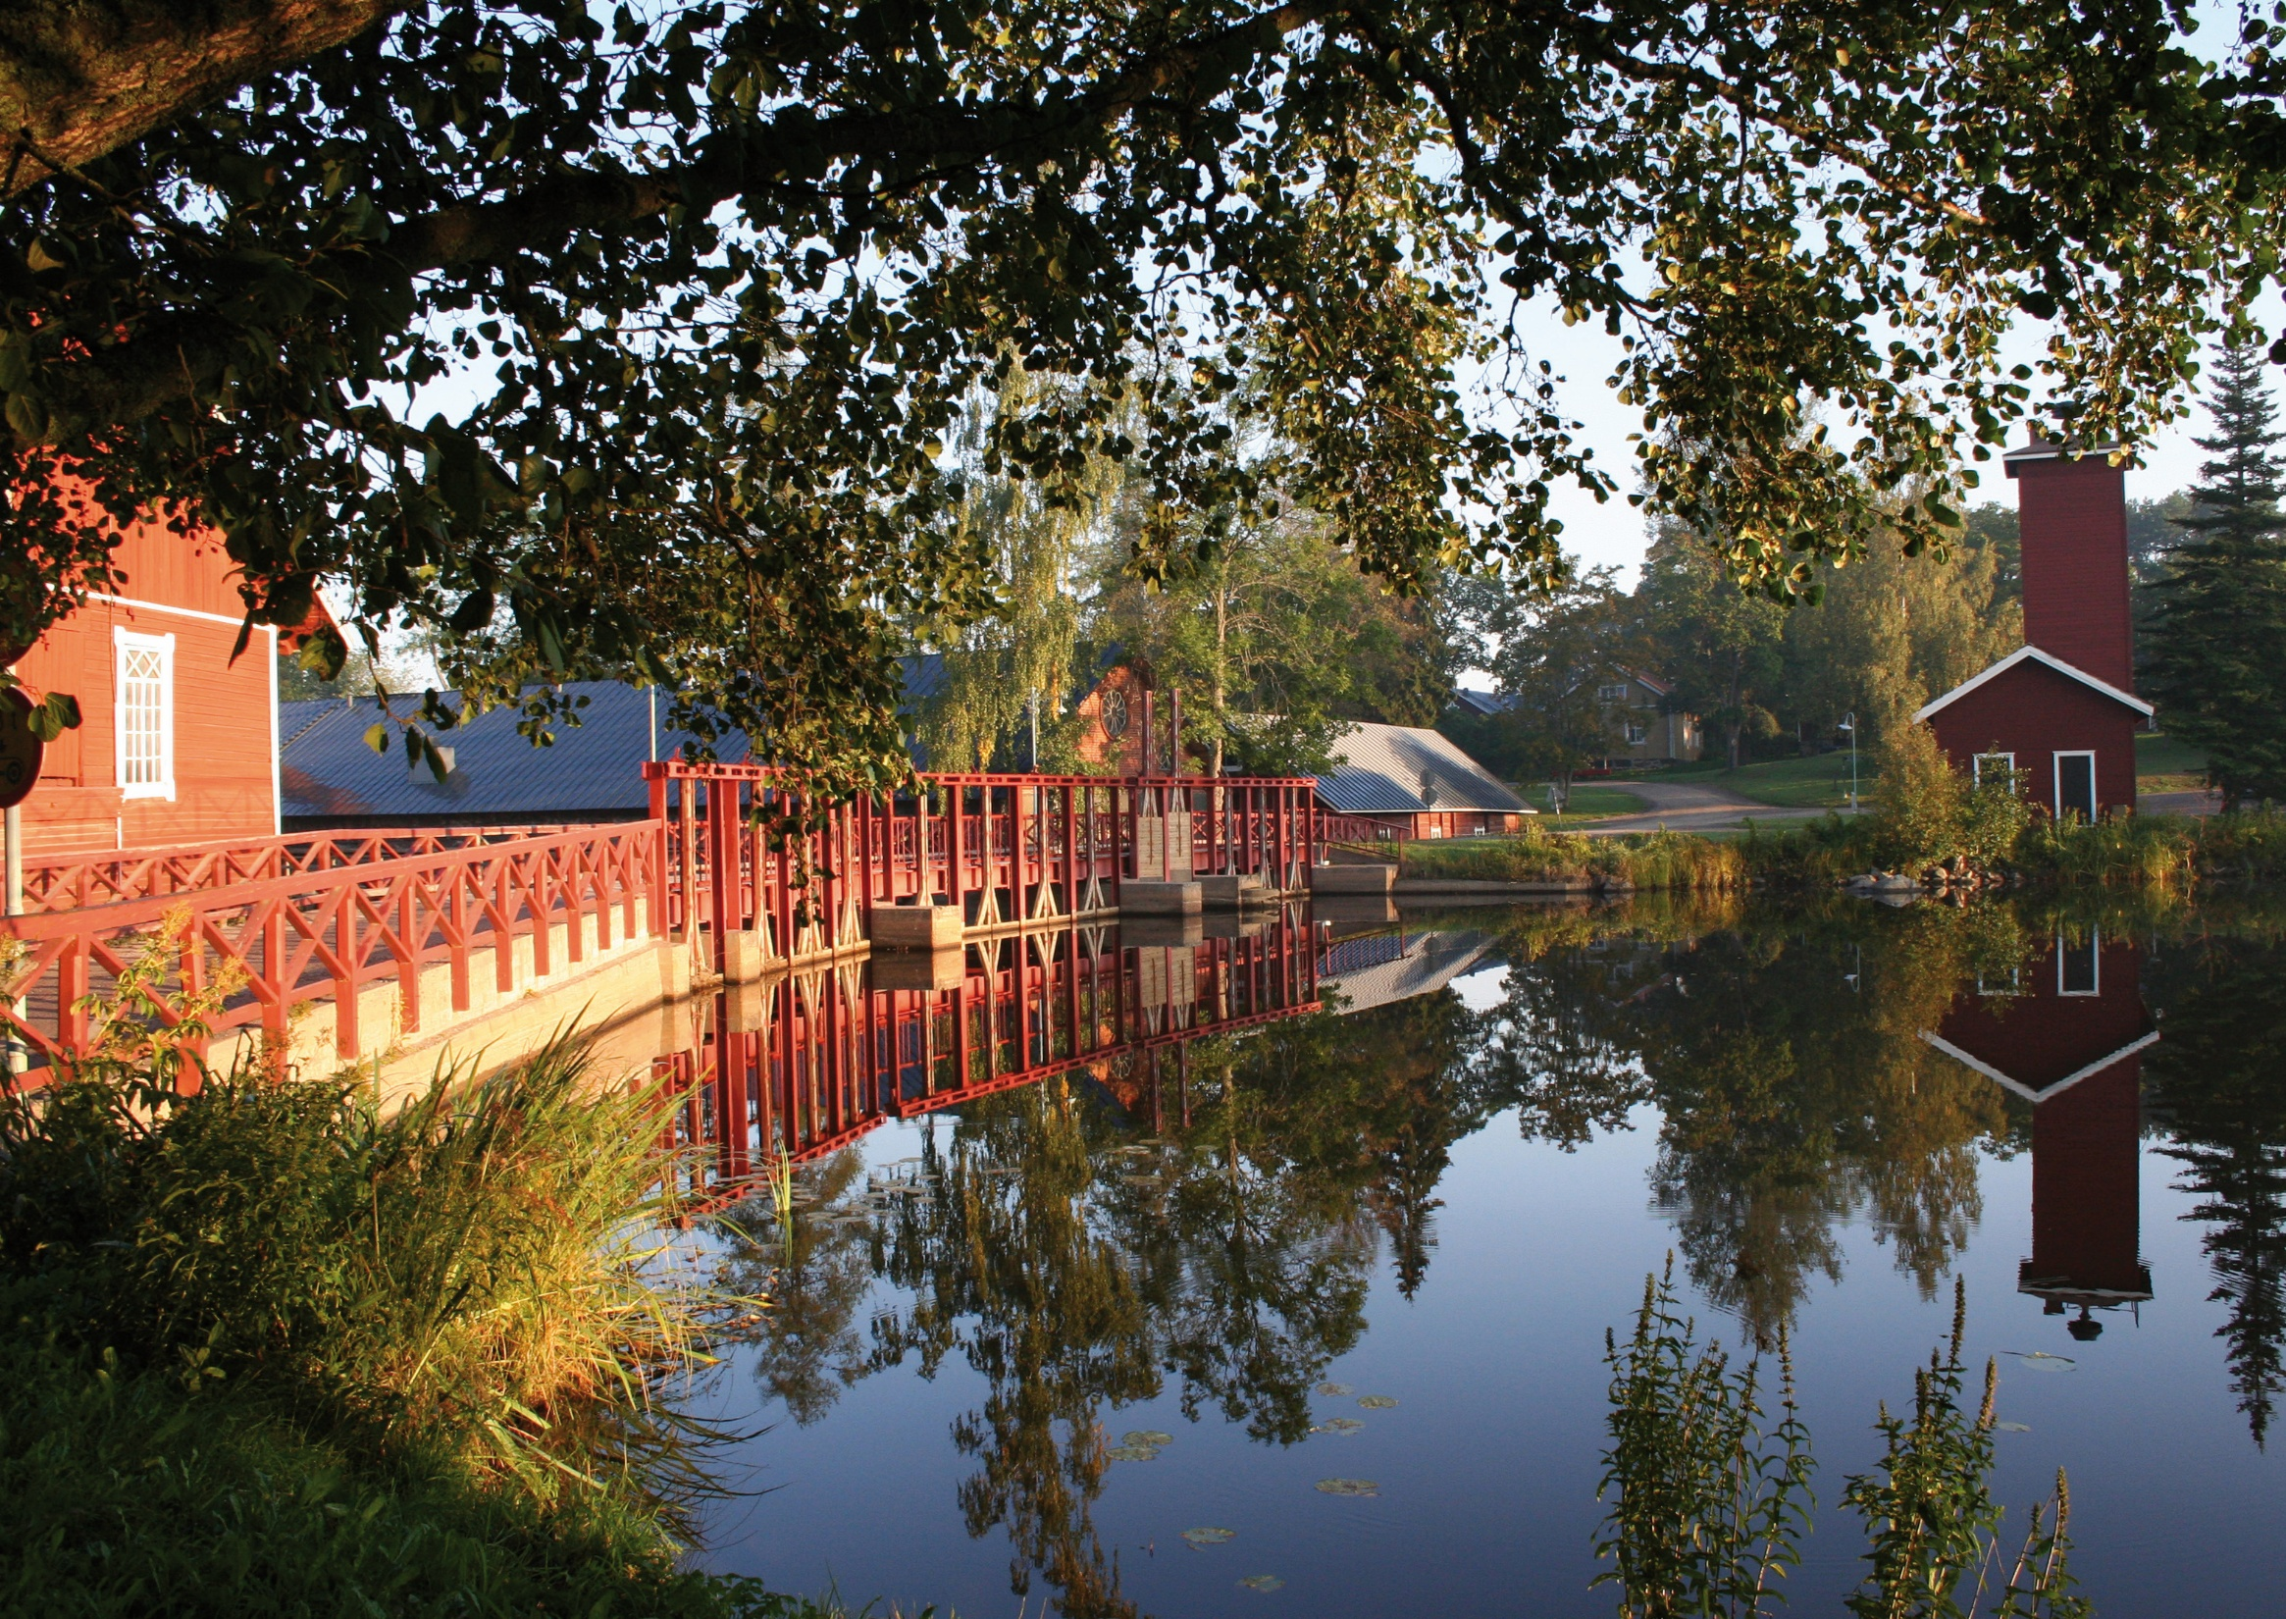
Map the partners
Which organisations could be involved in the network?
Who can become a member?
What types of organisations could benefit from being part of the Cultural Route network?
What kind of expertise does the network need from its members?
Photo: Ahlström Ironworks, Noormarkku
Notes:
Tips:
The network can define the types of member organisations it wants to target: Only certain types of organisations may be accepted into the route network (exclusive), or it may be open to different types of organisations related to the theme (inclusive). Examples of exclusive network: European Route of Historic Thermal Towns, that only accepts municipalities as a member / European Route of Industrial Heritage, that have many kinds of organisations as a member.
Summarise the benefits clearly - this will help communication with potential new members.
Points to consider:
Cultural routes must have a scientific basis.
When a Cultural Route is developing sustainable tourism, it is beneficial to establish connections with the tourism industry.
The network must include organisations that manage sites that can be visited.

Slide 7
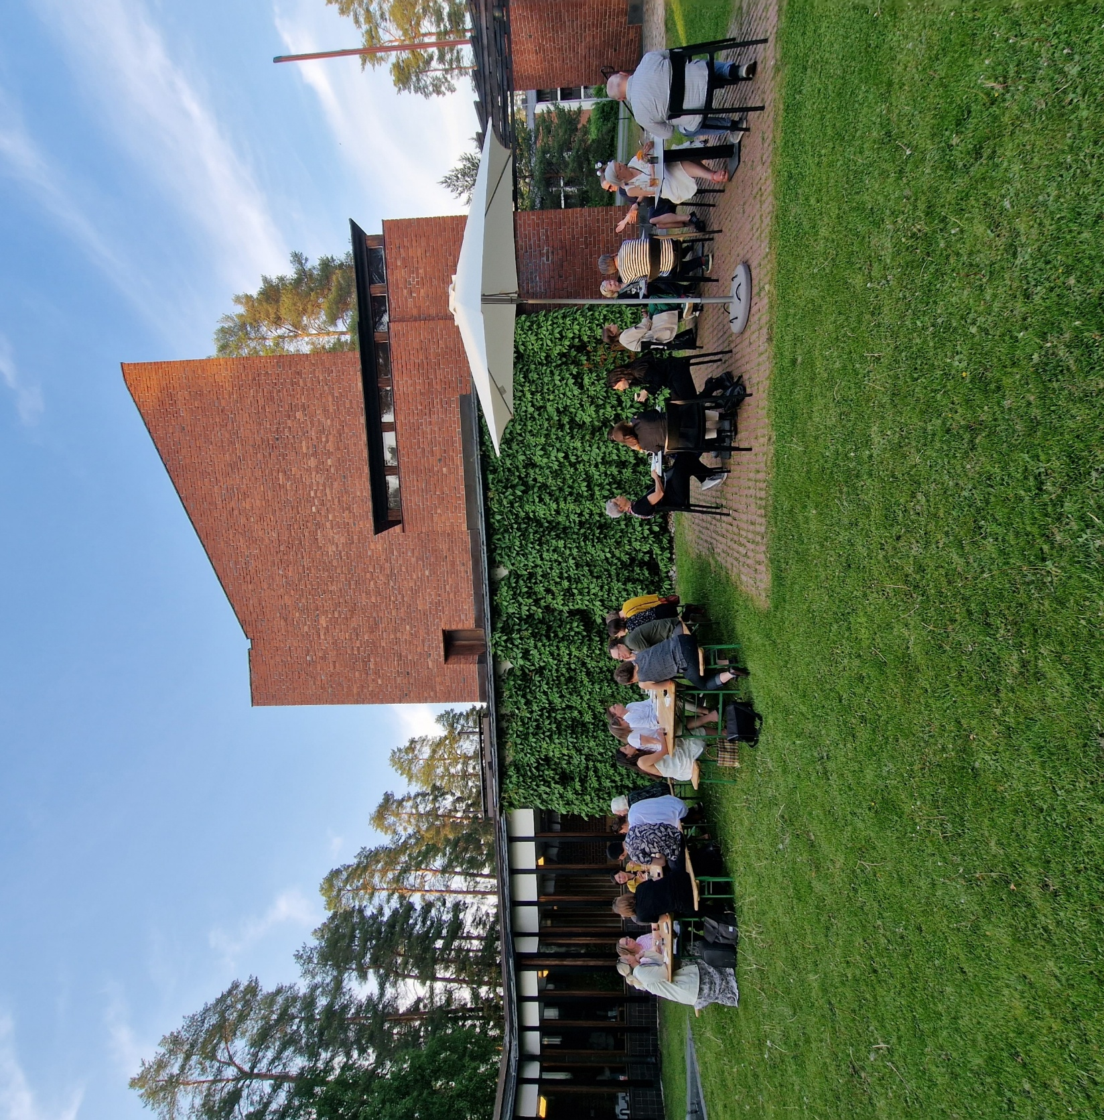
Organisation model
How should the membership categories be defined?
How should the membership fees be set for each category?
What kind of responsibilities (other than membership fee) can be set for members in each membership category?
Photo: Säynätsalo Town Hall, Harri Taskinen, Tavolo Bianco Oy
Notes:
Tips:
The organisational model can support the division of responsibilities within the route network. When defining responsibilities for members (In kind contributions), ensure that fulfilling these responsibilities brings concrete benefits to the organisation responsible. Responsibilities should serve the fundamental objectives of member organisations as effectively as possible.
Consider management structure. Do you need national contact points? Do you need to set up working groups to work with different priority fields of action?
Points to consider:
An association or consortium of associations must be established to manage the Cultural Route. The association must be established two years before applying for the certification, so in the early stages of the development work, it must be decided in which country the association will be established and who shall be responsible for its operations. The association must be established in a member state of the Council of Europe.
Route networks must have a scientific council, which is in practice a network of scientists and researchers that are working with the theme from different perspectives. Scientific councils support the route network and provide the scientific base.

Slide 8
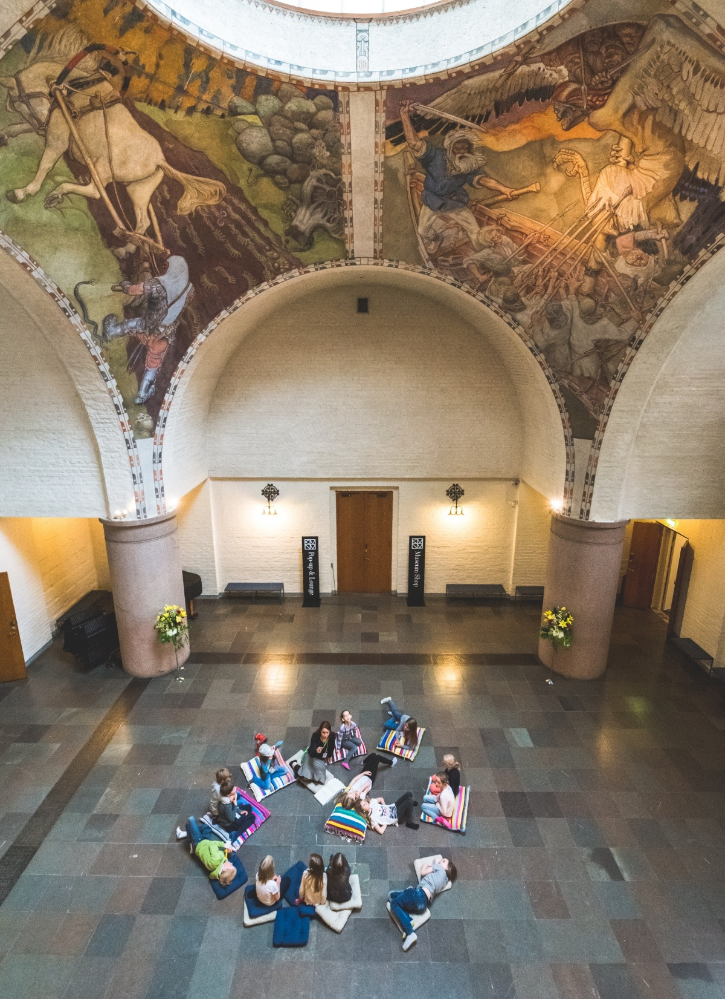
Plan Activities in Five Priority Fields of Action
What network members are already doing in relation
to the priority fields of action? Could existing activities be scaled up?
Consider whether it is necessary to focus on one priority fields of action slightly more than another? Where do you want to allocate resources at this stage? Can you identify a priority field of action that has received less attention but could bring benefits to the network if given more focus?
Brainstorm ideas for joint activities in different fields
of action for the route network.
Photo: Topi Leikas, Finnish Heritage Agency
Notes:
Questions to support detailed planning:
What is the schedule for the activities to be carried out?
What are the practical measures to be implemented?
What resources are required to implement the activities (financial and in-kind)?
Share responsibilities clearly.
Tips:
Consider integrating existing activities into the Cultural route network's activities by communicating about them through the network's communication channels.
Note that activities can be carried out on a small or large scale - the scale is determined by the resources available within the network.
Plan activities so that they support the activities of member organisations - members should be involved in planning activities!
Points to consider:
Cultural routes are expected to implement common activities in five priority fields of action:
Co-operation in research and development
Enhancement of memory, history and European heritage
Cultural and educational exchanges for young Europeans
Contemporary cultural and artistic practice
Cultural tourism and sustainable cultural development

Slide 9
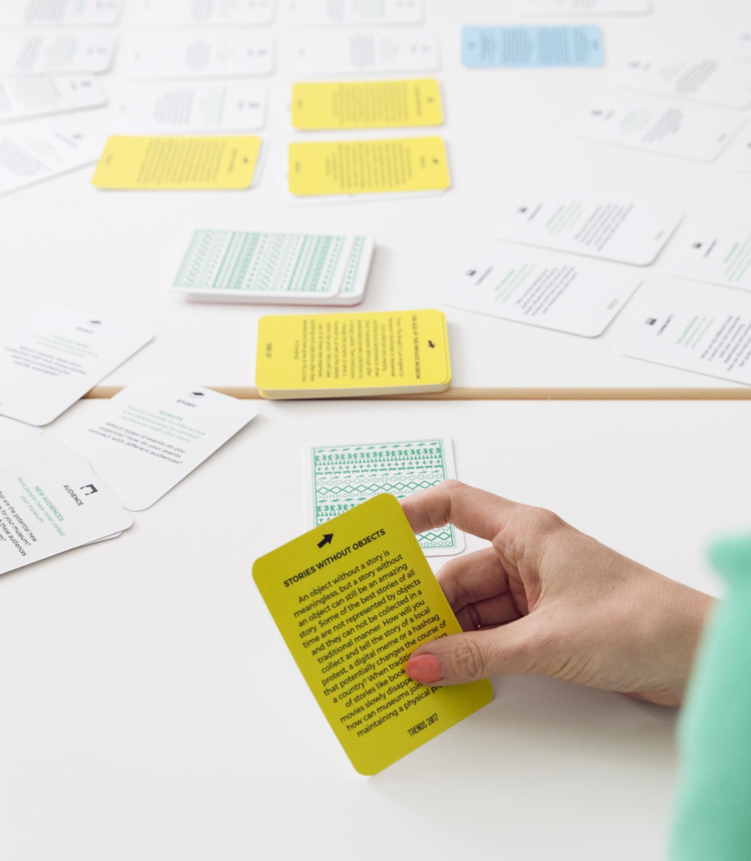

Plan Route Network Communication
Photo: Finnish Heritage Agency
Make a communication plan for the route network, consider:
What do you want to achieve with your communication actions? (For example: more visitors to the sites, more new members for the network, raising awareness of the culture heritage theme represented by the route, etc.)
What are the most important target groups for communication actions?
What are the key messages to different target groups?
Which communication channels are used?
What are the concrete communication actions and schedule? (For example: How often to post on social media channels, how often to produce newsletters, etc.)
Consider resources: both financial and in kind.
Notes:
Tips:
Consider whether the route network can promise members a certain level of visibility. For example, a certain number of posts on the route network's social media, etc.
Also consider whether members could be given responsibilities in communication actions (for example reposting social media posts of the route network).
Note that the route offers plenty of cross-marketing opportunities: encourage network members to communicate about the route sites and activities!
Points to consider:
Note that certification requires that the network has a website and social media communication channels. The program also sets requirements for the creation of a logo and graphic charter.
Note that the destinations visited along the route, how to get there, and any related tourism products and sales channels must be clearly communicated to visitors.

Slide 10
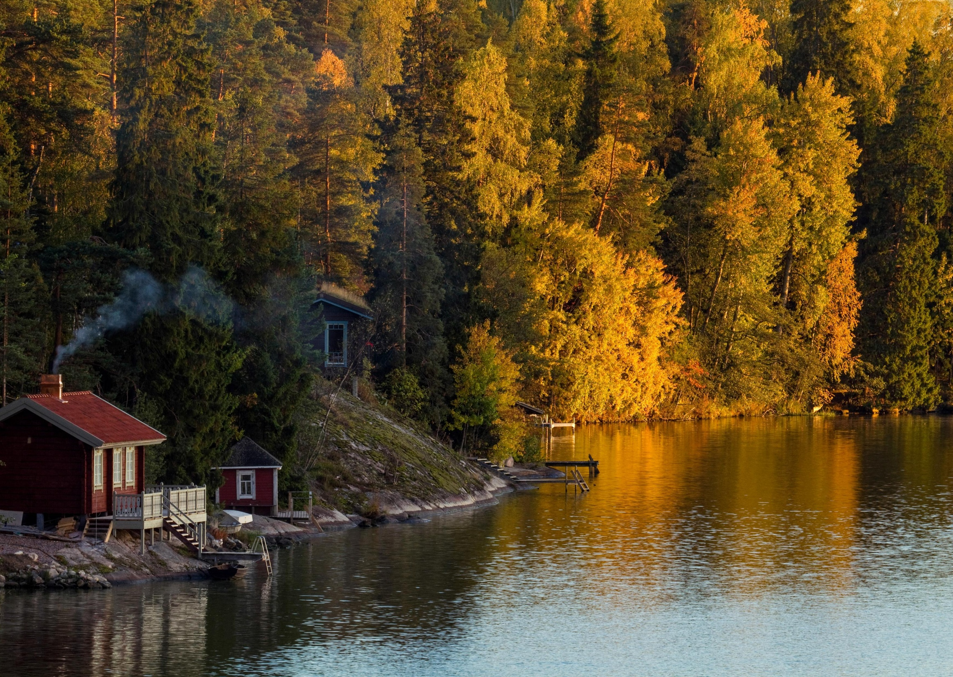
Risks and How We Prepare for Them
What risks are involved in developing/maintaining the Cultural Route? (For example, risks related to financing, organisation, resources etc)
How could risks be reduced?
How can you respond if the risk materialises?
Consider alternative courses of action in case the risks do materialise.
Phptp: Visit Finland

Slide 11
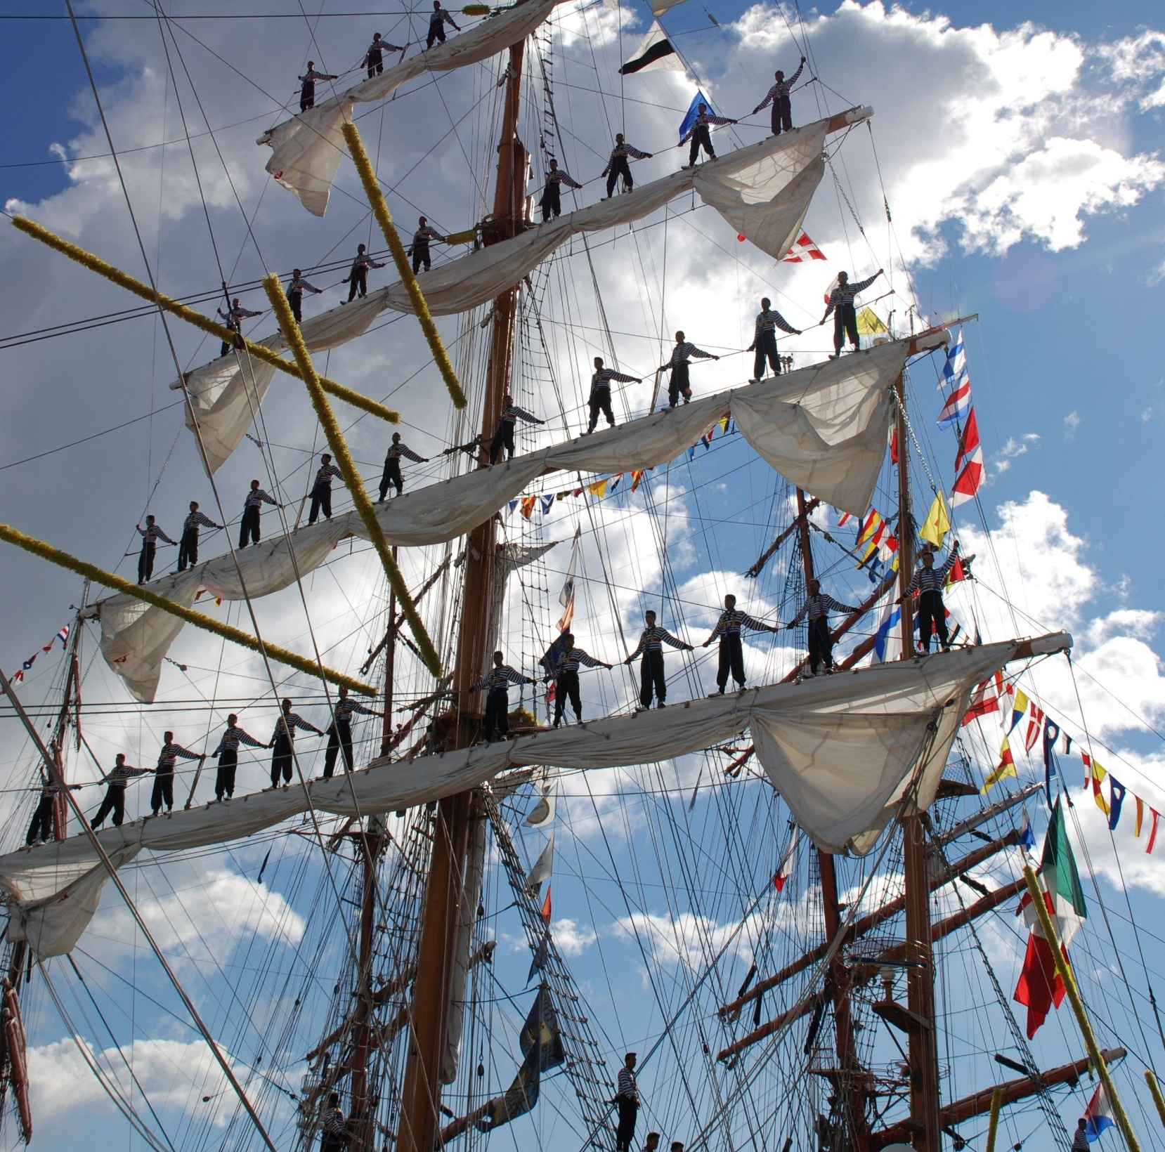
Monitoring and Regular Route Meetings
What metrics can you use to measure
the achievement of goals set together?
How do you develop a metric that captures the desired impact rather than just the number of activities carried out?
Photo: Erik Tirkkonen, The Finnish Maritime Museum’s Picture Collection, Finnish Heritage Agency
Notes:
Tips:
Include an assessment of the achievement of objectives in the agenda of the association's annual meeting each year.

